Slide 1
Introduction to Statistical Learning with Applications
CM1: Introduction, simple linear regression, and some multivariate statistics
Pedro L. C. Rodrigues

Slide 2
Structure of the course
CM
TD
TP
Pedro L. C. Rodrigues
pedro.rodrigues@inria.fr
TD
TP
Isabella Costa Maia
isabella.costa-maia@grenoble-inp.fr
CC
Razan Mhanna
Complementary courses
for M1AM students
razan.mhanna@inria.fr

Slide 3


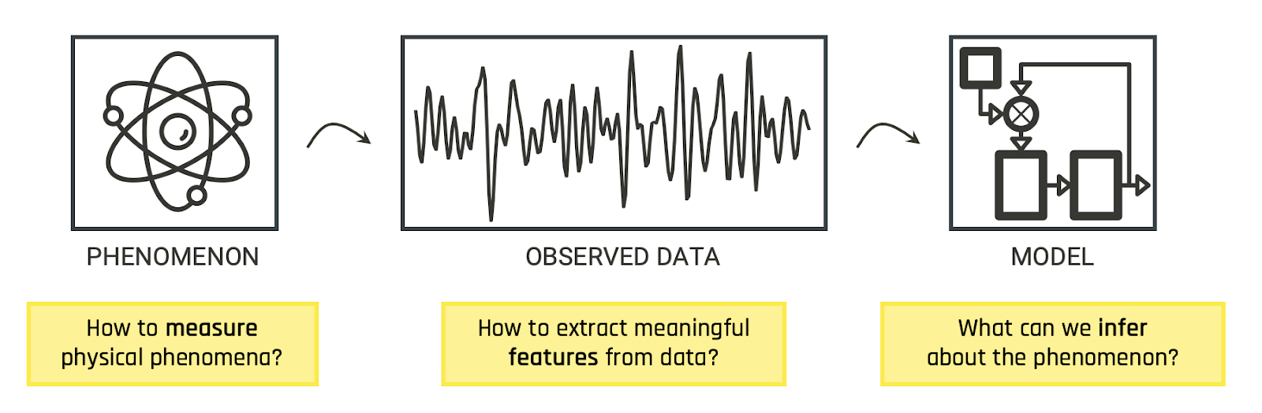
Pedro L. C. Rodrigues
Researcher at Inria Grenoble since 2021 (and teaching this class since 2018)
Working mostly with ML for experimental data (neuro, climate, astro)
Keywords: (Deep) generative modelling, simulation-based inference, geometry-aware ML methods

Slide 4

Administrative stuff
Course overview
Simple linear regression
Multivariate statistics

Slide 5
Administrative stuff
Course evaluation:
Your final grade will be equally split between
TD/TP GRADES
50%
FINAL EXAM
50%
3h exam similar to a TP session
= 0.20 x P + 0.30 x R + 0.50 x C
Individual performance on two data challenges
Group grades of three TP reports during the trimester
Presence and participation in the TD and TP sessions

Slide 6
Administrative stuff
Textbooks:
Our main reference is the book by James et al. "Introduction to statistical learning with applications to Python"
Another excellent reference is Hastie et al. "Elements of Statistical Learning”
Many of the examples in this course are taken from Cosma Shalizi’s “The truth about linear regression”
The links to all these materials are available on the course website

Slide 7
Administrative stuff
About the practical sessions aka Travaux Pratique (TP):
All sessions are to be done using Python -- 🙂 and 😕
Teams of three students to be declared here
Each group should have a gitlab or github repo to upload their reports
Three TPs with deadlines informed in the website
All reports are to be written in English and in ipynb format
Suggestions:
Use as much as possible the computers from ENSIMAG
Avoid depending too much of fancy libraries and packages
Doing extra investigations and including references will be appreciated

Slide 8

Tour on the course website
Website: github.com/ISLA-Grenoble/

Slide 9
Administrative stuff
Course overview
Simple linear regression
Multivariate statistics

Slide 10
Course overview
We will be dealing with three main statistical tasks
Regression: how can we relate a continuous variable to another set of variables?
Classification: how can we relate a discrete variable (i.e. a label) to another set of variables?
Clustering: can we detect classes in a dataset and split its samples accordingly?

Slide 11

Regression
How can we relate a continuous variable to another set of variables?
Example
Can we predict the average price of houses in a district given the average income of people living there?
California housing dataset

Slide 12
Regression
How can we relate a continuous variable to another set of variables?
Example
Can we predict the average price of houses in a district given the average income of people living there?
VALUE
VALUE ≈ β₁ x INCOME + β₀
INCOME
California housing dataset

Slide 13
Regression
How can we relate a continuous variable to another set of variables?
Example
VALUE ≈ β₁ x INCOME + β₀
VALUE
How significant are the parameters in the model? Can we define confidence intervals? Is the linear model a good one?
↳ Should we include more predictors?
INCOME
California housing dataset

Slide 14
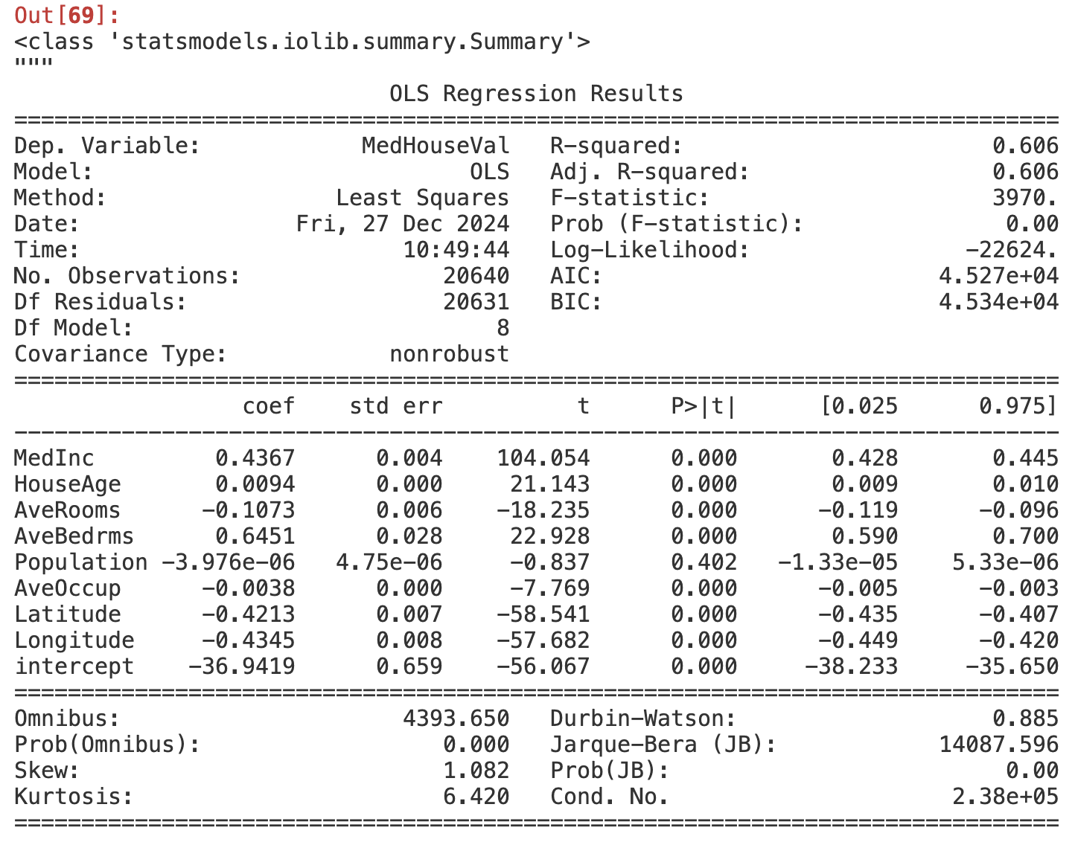

Slide 15
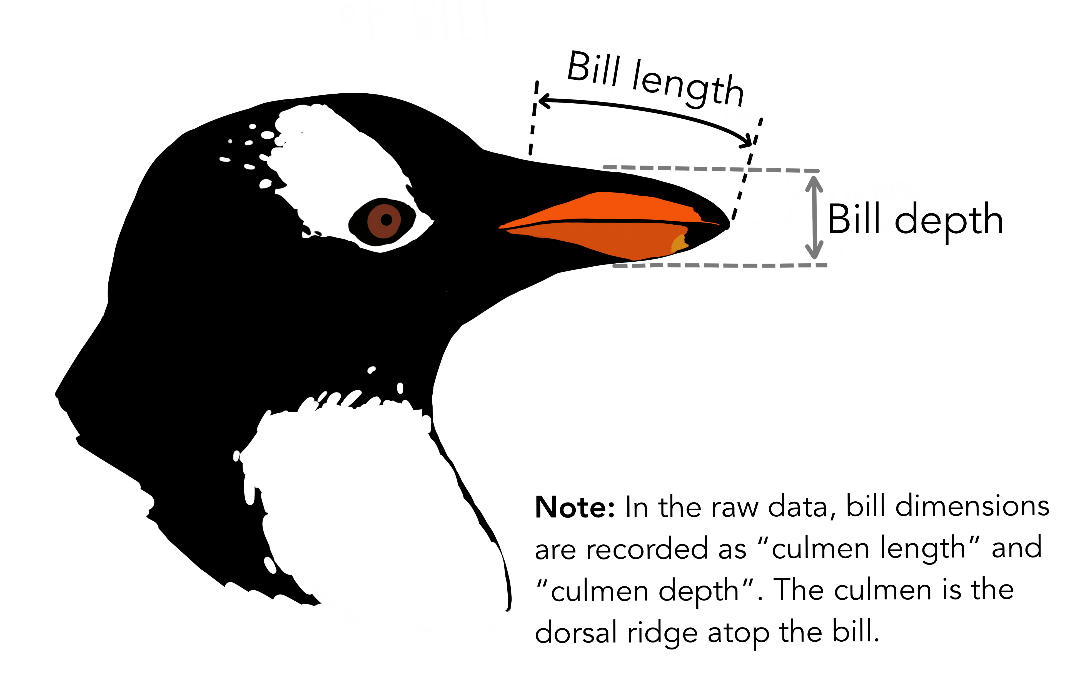
Classification
How can we relate a discrete variable (i.e. a label) to another set of variables?
Example
Can we use the dimensions of a Penguin beak (aka bill) to classify him into one of three species?

Slide 16
Classification
How can we relate a discrete variable (i.e. a label) to another set of variables?
Example
Can we use the dimensions of a Penguin beak (aka bill) to classify him into one of three species?
BILL DEPTH
BILL LENGTH

Slide 17
Clustering (and community detection)
Can we detect classes in a dataset and split its samples accordingly?
Example
Can we understand social relations using statistical analysis on graphs?
Nodes are students at a US high school and colors encode race. Using community detection in this situation helps understanding the social interactions in the school and evaluate which actions can be made for better integration.

Slide 18
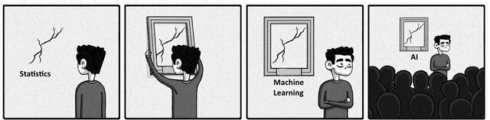
Statistical Learning Vs Machine Learning
“When you’re fundraising, it’s AI.
When you’re hiring, it’s ML.
When you’re implementing, it’s logistic regression.”

Slide 19
Statistical Learning Vs Machine Learning
We will be following more of a statistician’s approach to machine learning
Flexibility (e.g. neural networks) Vs Interpretability (e.g. linear models)
Understand the inner workings of building blocks for more complex models
Under which conditions is the linear regression model reliable?
What sort of errors does the linear regression model can make ?
What can the linear regression model tell us when it works?
What are the signs that something has gone wrong?

Slide 20
Some tools we will be using all the time and that you shold review on your own!
Probability & Statistics
Hypothesis tests
Expected value, variance, covariance
Probability density function, CDF
Conditional probability
Null hypothesis and p-value
Confidence intervals
t-test, F-test
Multivariate calculus
Matrix analysis
Gradient and Hessian
Multivariate integrals
Change of variables, chain rule
Eigenvalues and eigenvectors
Symmetric positive definite matrices
Trace, rank, norm

Slide 21
Concepts you will learn in this course … and that you can mention during your internship interviews 😉
Multiple linear regression in the statistician’s way
Principal component analysis aka PCA or ACP in 🇫🇷
Cross-validation and overfitting, model selection
Linear classification with discriminative and generative models
Decision trees and random forests
Ensemble methods: stacking, bagging, and (gradient) boosting
Introduction to social network analysis

Slide 22
Administrative stuff
Course overview
Simple linear regression
Multivariate statistics

Slide 23
Simple linear regression
“One of the things that people most often want to know about the world is how different variables are related to each other, and one of the central tools in statistics to tackle this question is regression.” Cosma Shalizi in “Advanced Data Analysis from an Elementary Point of View”
1.1 0.5
1.9 1.1
3.1 1.4
4.0 2.0

Slide 24
Simple linear regression
“One of the things that people most often want to know about the world is how different variables are related to each other, and one of the central tools in statistics to tackle this question is regression.” Cosma Shalizi in “Advanced Data Analysis from an Elementary Point of View”
Q:
What is the optimal point forecast for a random variable Y ?

Slide 25
Simple linear regression
“One of the things that people most often want to know about the world is how different variables are related to each other, and one of the central tools in statistics to tackle this question is regression.” Cosma Shalizi in “Advanced Data Analysis from an Elementary Point of View”
Q:
What is the optimal point forecast for a random variable Y ?
A:
One possible way is to minimize the mean squared error

Slide 26
Simple linear regression
Q:
What if instead of just using one constant number to predict Y we used some function 𝜇 of another random variable X as our estimate?

Slide 27
Simple linear regression
Q:
What if instead of just using one constant number to predict Y we used some function 𝜇 of another random variable X as our estimate?
A:
Our new optimization problem is
with solution
Conclusion: the mean-squared optimal conditional prediction of Y in terms of X is the conditional expected value of Y for a fixed X

Slide 28
Y
X

Slide 29
Y
X

Slide 30
Y
X

Slide 31
Y
X

Slide 32
Simple linear regression
Q:
What if instead of just using one constant number to predict Y we used some function 𝜇 of another random variable X as our estimate?
A:
Our new optimization problem is
with solution
Conclusion: the mean-squared optimal conditional prediction of Y in terms of X is the conditional expected value of Y for a fixed X
But how can we estimate the conditional expectation from observed data?

Slide 33
Simple linear regression
In principle, the conditional expectation could be anything. But this would be hard.
We will restrict our function space to linear models as per
The parameters are thus estimated by minimizing the MSE
for which the minimizers are

Slide 34
Y
X

Slide 35
Simple linear regression
Some insights and comments:
The optimal slope increases the more X and Y tend to fluctuate together and gets pulled towards zero the more X fluctuates by itself.
The expected values of X and Y play no role in the slope (only the variances and covariances). Therefore, the optimal slope does not change if we re-center the data

Slide 36
Simple linear regression
How do we estimate the coefficients from observed data?

Slide 37
Simple linear regression
OK, we could stop here… like most machine learning courses do.
But how can we answer those questions that I mentioned previously?
Under which conditions is the linear regression model reliable?
What sort of errors does the linear regression model can make ?
What can the linear regression model tell us when it works?
What are the signs that something has gone wrong?
We need to make some assumptions on the data generative model

Slide 38
Simple linear regression
DATA
Y
X

Slide 39
Simple linear regression
DATA GENERATIVE MODEL
Y
X
Assumption: “Quantity Y depends linearly on the values of X and random noise”

Slide 40
Simple linear regression
DATA GENERATIVE MODEL
Y
Y
X
X
Assumption: “Quantity Y depends linearly on the values of X and random noise”
Assumption: “Quantity Y depends quadratically on X and random noise”

Slide 41
Simple linear regression
DATA GENERATIVE MODEL
REGRESSION MODEL
Y
X
Assumption: “Quantity Y depends linearly on the values of X and random noise”

Slide 42
Simple linear regression
DATA GENERATIVE MODEL
REGRESSION MODEL
Y
X
Assumption: “Quantity Y depends linearly on the values of X and random noise”
The hat-parameters are estimated from observed data and expected to converge to the true parameters

Slide 43
Simple linear regression
Assumption: “Quantity Y depends linearly on the values of X and random noise”
The additive noise is assumed to have three important properties:
Zero mean
Constant variance
No correlation with the values of X
Note that we make no assumption about p(X) (what does this imply?)
The assumption of additive noise is non-trivial, but a very common one.
Ideally, we should always check these assumptions…

Slide 44
Gaussian simple linear regression
It is also common (though not trivial) to assume a Gaussian additive noise, i.e.
which is the same as saying that the generative model of the data is
We can even write the statistical distribution of the estimated parameters

Slide 45
Gaussian simple linear regression
Coming back to our example with the California housing dataset
Example
Can we predict the average price of houses in a district given the average income of people living there?
California housing dataset

Slide 46
Gaussian simple linear regression
Q:
But how can we ensure that the assumptions of the model are respected?
We can rewrite the Gaussian regression model as
and we define the residuals of our estimation as in
With a little bit of magic algebra we can obtain an expression for the residuals

Slide 47
Gaussian simple linear regression
Q:
But how can we ensure that the assumptions of the model are respected?
So if the assumptions of the Gaussian simple linear regression are satisfied, then:
The residuals should have expectation zero conditioned on X
The residuals should show a nearly-constant variance
The residuals should have a Gaussian distribution
In practice, they never are… so it should be “almost” Gaussian

Slide 48
Gaussian simple linear regression
So if the assumptions of the Gaussian simple linear regression are satisfied, then:
The residuals should have expectation zero conditioned on X
The residuals should show a nearly-constant variance
The residuals should have a Gaussian distribution
Residuals
AvgIncome

Slide 49
Gaussian simple linear regression
After using some pre-processing tricks…
Filter the thresholded house values
Apply a logarithmic transformation to the target values

Slide 50
Gaussian simple multiple linear regression
The next natural step would be to model the data using p predictors
where the p+1-dimensional vector of parameters can be estimated via
How to describe the statistics of the vector of estimated parameters?

Slide 51
Administrative stuff
Course overview
Simple linear regression
Multivariate statistics

Slide 52
Basic concepts of multivariate statistics
Consider a random vector defined in
where each is a random variable
Expectation
Covariance Matrix

Slide 53
Gaussian vectors
A random vector is a Gaussian vector if, and only if, every linear combination
of its components has a normal distribution
We denote it as with and
and the pdf is

Slide 54
Gaussian vectors
The equidensity contours are ellipsoids centered at the mean
X₂
X₁

Slide 55
Gaussian vectors
The equidensity contours are ellipsoids centered at the mean
X₂
Y₂
Y₁
X₁

Slide 56
Gaussian simple multiple linear regression
Coming back to our problem of Gaussian multiple linear regression
we can write that

